Slide 1

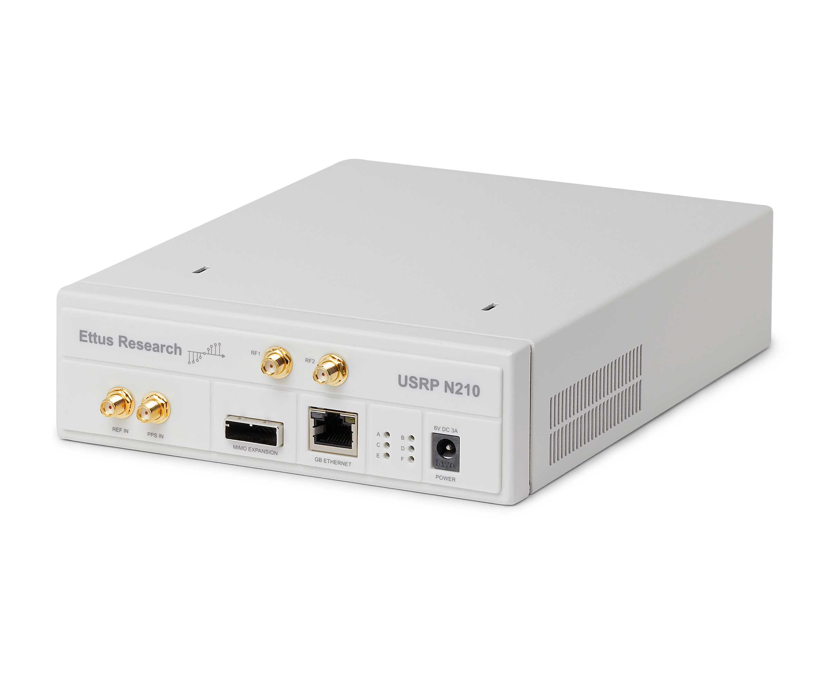
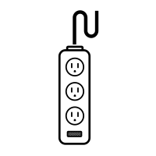
Transmitter
Receiver
TX/RX port
RX port
a cable with 30dB attenuation
5Gb ethernet cable
5Gb ethernet cable
USRP power supply cord
USRP power supply cord

